Slide 1
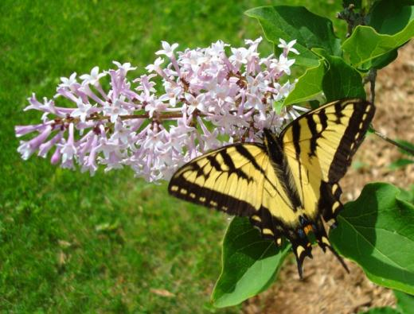
Pollinator Protection for Pesticide Applicators
Gary Fish
Maine Board of Pesticide Control
28 SHS
Augusta, ME 04333-0028
207-287-7545
gary.fish@maine.gov

Slide 2

Life with bees….
Whole Foods Market
Marla Spivak, University of Minnesota

Slide 3

… and without bees
Marla Spivak, University of Minnesota
Whole Foods Market

Slide 4

Marla Spivak, University of Minnesota
David Hansen

Slide 5
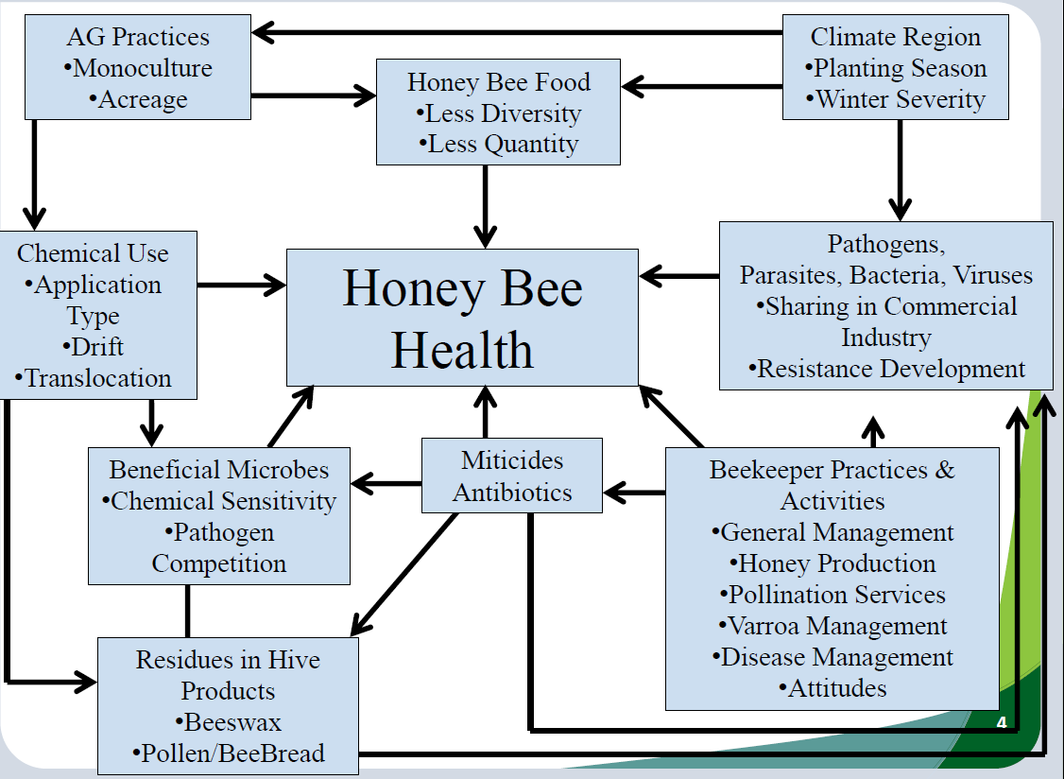

Slide 6
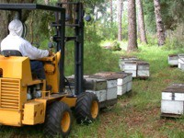
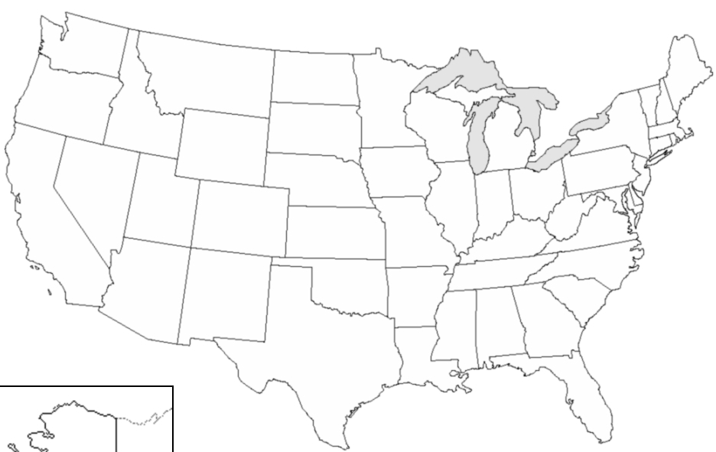










Major Migratory Routes of Honey Bee Colonies for Pollination
Marla Spivak, University of Minnesota

Slide 7

Importance of Pollinators
Fruit and seed production needed for the survival of the majority of flowering plants in our environment.
Essential to the
production of more
than 85 crops.
1 out of every 3 bites
of food can be attributed to pollinators.

Slide 8
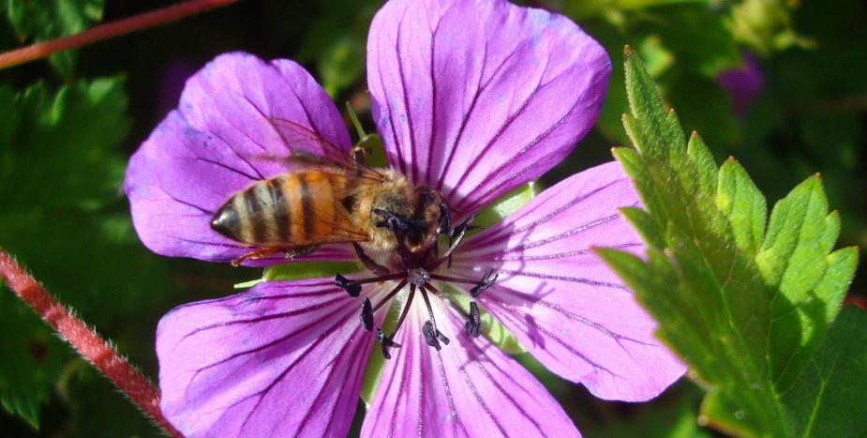
Who Are the Pollinators?
Honey bees are relied on to perform most of the commercial pollination.

Slide 9
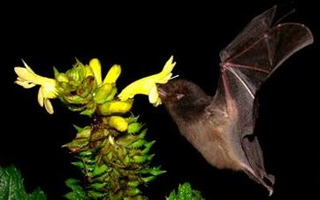
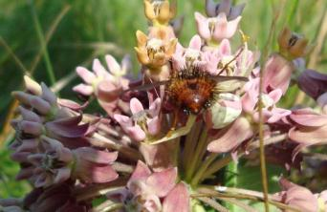
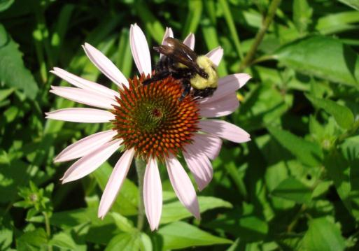
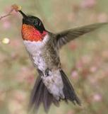
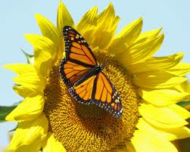
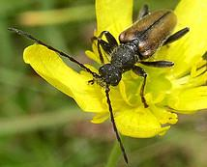
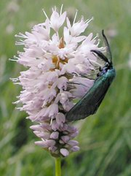
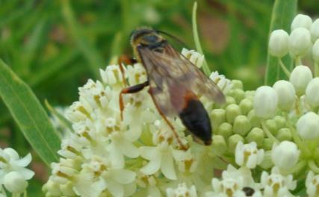
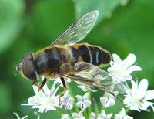
What organisms serve as pollinators?
Notes:
A pollinator is the agent that moves pollen from the male anthers of a flower to the female stigma of a flower to accomplish fertilization
There are different types of pollinators: bees, butterflies and moths (they are important pollinators of wildflowers), wasps, flies, even beetles, thrips, or ants can pollinate self fertile flowers.
Bats are important pollinators of tropical flowers. Hummingbirds accomplish pollination of deep throated flowers

Slide 10
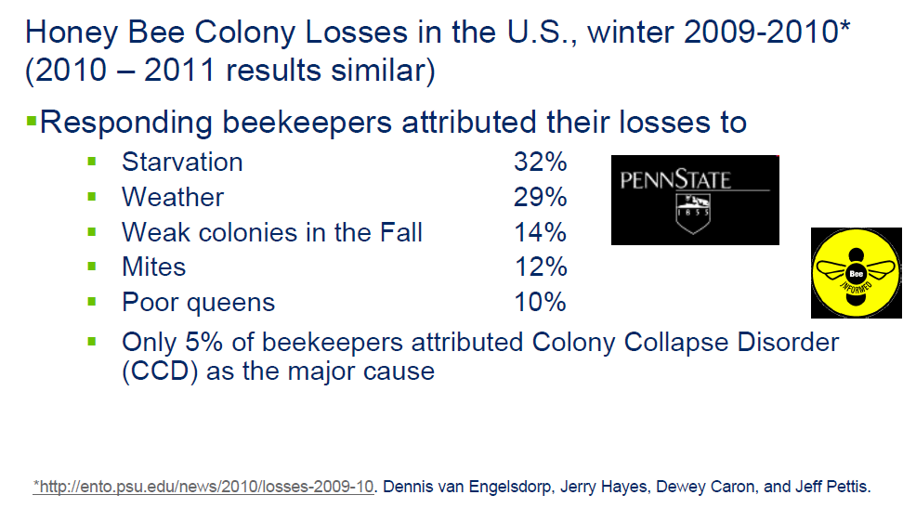
Bee Decline from the beekeeper point of view -2009-2010 winter losses

Slide 11
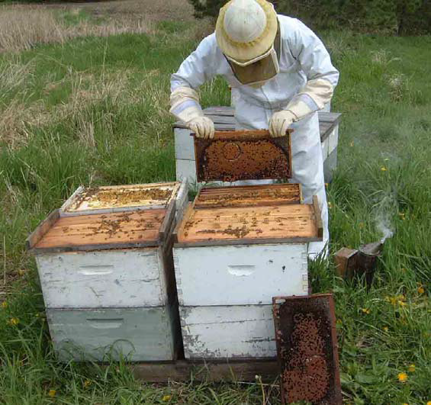
Bee Decline from the beekeeper point of view - 2011-2012 winter losses
Factor | % Selecting That Factor
Poor Wintering Conditions | 36.71
CCD | 35.99
Pesticides | 33.72
Varroa | 25.64
Nosema | 25.13
Weak in the Fall | 24.10
Queen Failure | 21.81
Don't Know | 21.58
Starvation | 20.89
Small Hive Beetle | 19.78
http://www.beeccdcap.uga.edu/documents/spivak466.pdf

Slide 12
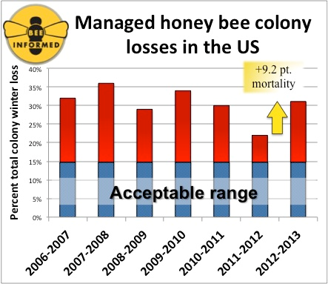
Winter Loss Survey Results
Over 7 Years

Slide 13
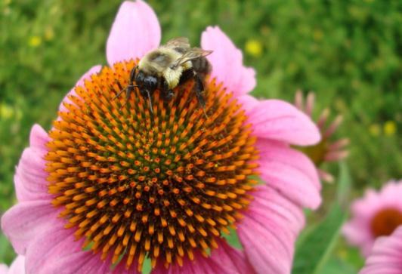
National Stakeholders Conference on Honeybee Health - Key Findings
Parasites and disease are major factors
Increased genetic diversity is needed
Poor nutrition has a major impact on bee and colony longevity
  Mono-cropping may contribute to dietary deficiencies

Slide 14
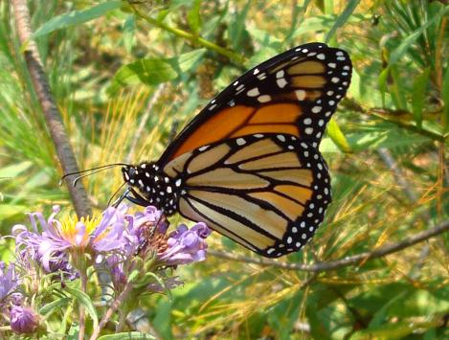
National Stakeholders Conference on Honeybee Health - Key Findings
Need to improve collaboration and information sharing
Additional research is needed to determine pesticide risks
Undernourished or malnourished bees appear to be more susceptible to pathogens, parasites, and other stressors, including pesticides and other environmental contaminants.
    Research is needed on forage, pollen quality, artificial and natural food sources, and food processing and storage in the hive.

Slide 15
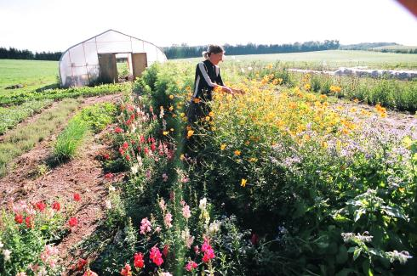
National Stakeholders Conference on Honeybee Health - Key Findings
Federal and state partners should consider actions affecting land management to maximize available nutritional forage
  to promote and enhance good bee health and
  to protect bees by keeping them away from pesticide-treated crop acreage.
Consider adding a bee pasture!

Slide 16
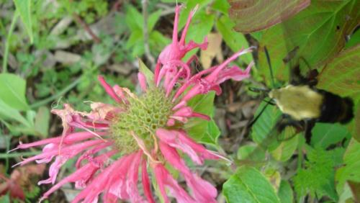
National Stakeholders Conference on Honeybee Health - Key Findings
Pathogens and parasites have major negative impacts on colonies. The management of the parasitic Varroa mite and viruses needs special attention.
More outreach to farmers on managing potential exposure of honey bees to pesticides is needed.
    Efforts would benefit from involvement of beekeepers, crop consultants, pesticide manufacturers, pesticide applicators, state pesticide control agencies and extension educators.

Slide 17
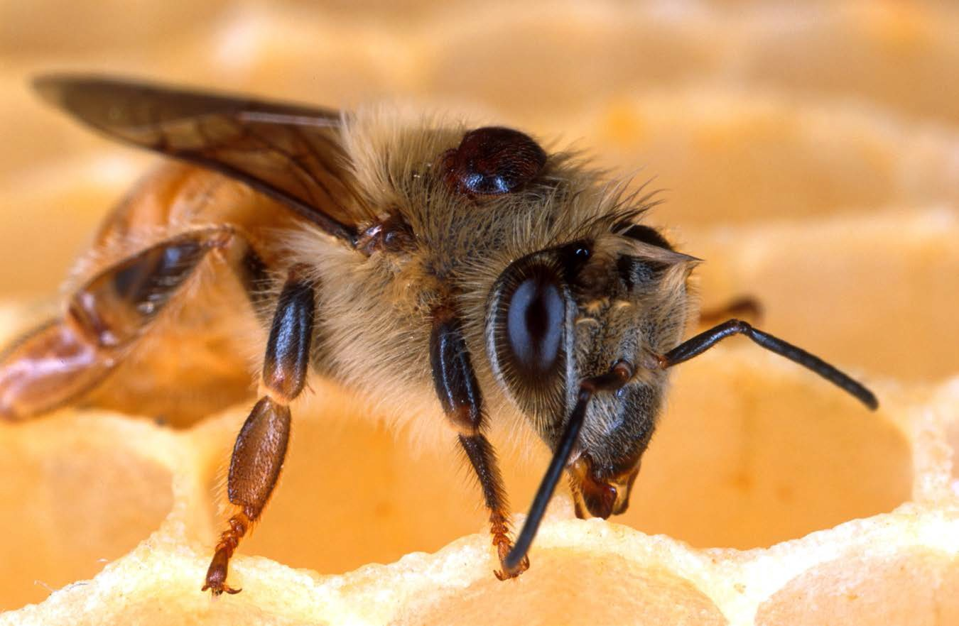

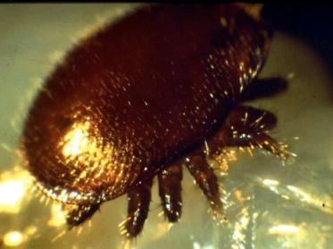

Varroa destructor mite
sucks bee blood and circulates viruses
Marla Spivak, University of Minnesota

Slide 18
National Stakeholders Conference Key Findings
Best management practices associated with bees and pesticide use exist, but are not widely or systematically followed by members of the crop producing industry.
    We need informed and coordinated communication between growers and beekeepers and effective collaboration between stakeholders.
Sources for BMPs:
1. Protecting Pollinators: Why and How Pesticide Applicators Can Help Them. North American Pollinator Protection Campaign.
2. How to Reduce Bee Poisoning from Pesticides. L. Hooven, R. Sagili, and E. Johansen.
3. Protecting Honey Bees from Pesticides. Malcolm Sanford, Univ. of FL.
4. Bee Health: The Role of Pesticides. Congressional Research Service 7-5700.
5. Pollinators and Pesticide Stewardship. Coalition for Urban/Rural Environmental Stewardship, Syngenta, and Bayer CropScience.

Slide 19
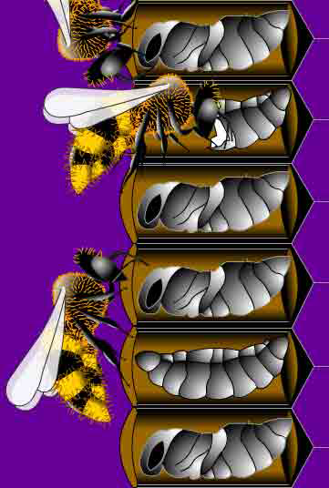
National Stakeholders Conference Key Findings
Beekeepers accentuated the need for accurate and timely bee kill incident reporting, monitoring, and enforcement.
Breeding should emphasize traits such as hygienic behavior that confer improved resistance to Varroa mites and diseases (such as American Foulbrood).
http://www.beeccdcap.uga.edu/documents/spivak466.pdf

Slide 20
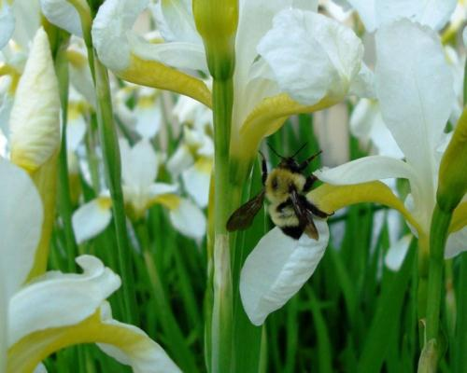
Managed Pollinator Coordinated Agriculture Program Update Highlights
Varroa mite is vector of Israeli Acute Paralysis Virus (IAPV) which is a potentially serious problem
Sentinel apiary study –
  Bee mortality increases as Ag land % increases
  6.2 pesticides on average found in bee pollen
  130 different pesticide residues found but no trend associated with bee mortality
  High levels of varroa = high levels of IAPV = low populations of adult bees and brood

Slide 21

Managed Pollinator Coordinated Agriculture Program Update Highlights
High degree of cross-infection of viruses between honey bees and native bumble bees
Bee susceptibility to interactions (synergism) between agricultural insecticides and fungicides
Some of those fungicides include, chlorothalonil, boscalid, captan, propiconazole and myclobutanil
Acetamiprid is not very toxic to bees on its own, but when combined with propiconazole it becomes 900times more toxic

Slide 22

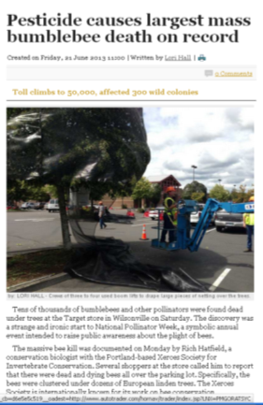
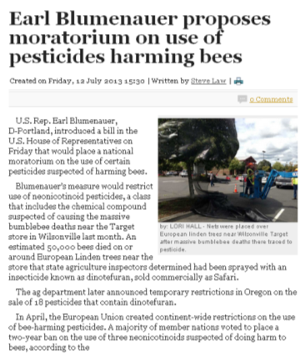
Pollinator Protection
Bee kills are in the news! Legislators are asking for bans or moratoriums all over the country
Growers must be extremely careful
This case involved “Safari” which is dinotefuran that was applied to control aphids just some linden trees had started to bloom
The applicator was fined $1,665.00 for not following the label
Portland, Oregon

Slide 23
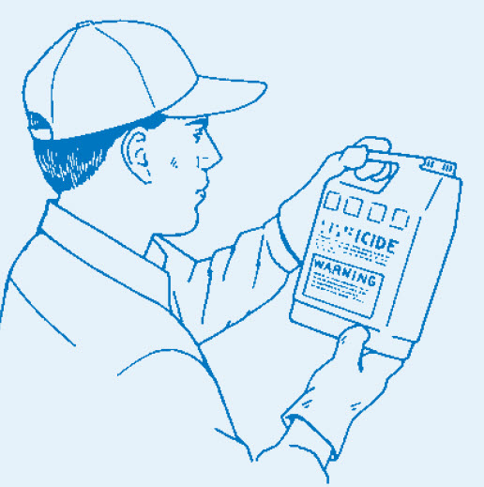
Pesticide applicators must reduce risks to honey bees and other pollinators.
Read the label
Use IPM
Follow Best
Management
Practices
Penn State Pesticide Education Program

Slide 24
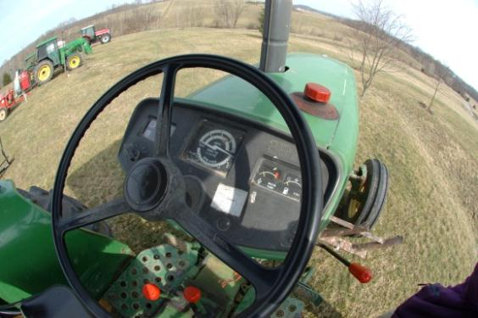
What Can You Do…?
As an applicator…
  Choose an insecticide with low hazard to bees
  Communicate with beekeepers
  Timing of application
pesticidepics.org
Notes:
Notify the beekeeper about application time and product to be used; so he can anticipated outcomes.
Timing of insecticide application: Never spray a crop in bloom unless it's absolutely necessary. If spraying a crop in bloom is necessary, spray when there will be minimal bee activity, preferably during the evening hours. Evening spraying also allows the insecticide to dry on the crop before bee activity begins the next morning.
Modify control programs according to weather. Cold temperatures prolong the residual of insecticide while warm temperatures break down insecticides more rapidly. Warm temperatures in late afternoon, early evening or early morning can "hold" bees in blooming fields for longer periods. Pay attention to wind direction and velocity in relation to nearby beeyard locations.
Why is the beekeeper hesitant to move or why does he sometimes leave the colonies in the area?
Logistics is the main reason. Cost of moving hives at least 2 miles away.

Slide 25
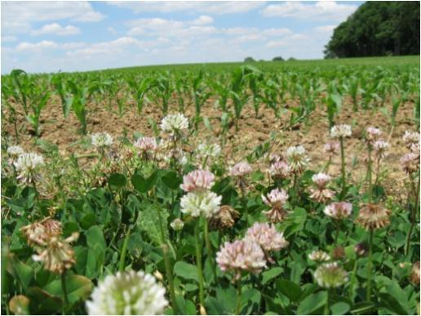
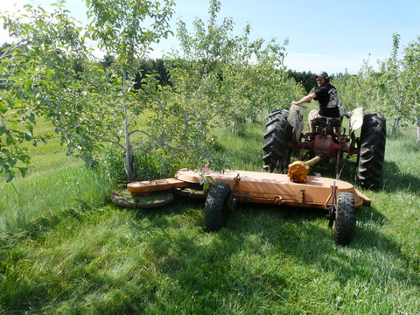
What Can You Do…?
  Avoid drift
  Good weed control in fields
  Be aware of blooming plants in the area when applying pesticides
  Mow blooming weeds around application sites before application, when possible

Slide 26
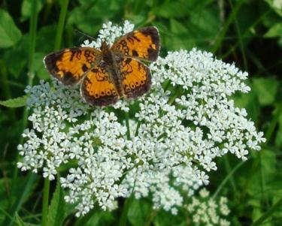
Did You Know?
Most pesticides are not acutely toxic to honey bees and other pollinators.
As a general rule: insecticides pose greater concerns to pollinators than fungicides and herbicides, but all can have impacts.
  However, not all insecticides are toxic to pollinators.

Slide 27
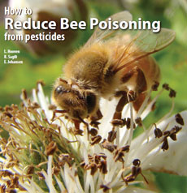
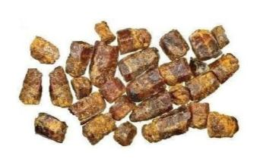
Did You Know?
New research shows that some combinations of insecticides and fungicides can be very toxic to bees.
Research also shows that pollen contaminated with some fungicides can impact bee larvae by interfering with beneficial microbes used in making the “bee bread” (fermented pollen).
Any pesticide that is toxic to insect pollinators will have new warnings on its label.

Slide 28
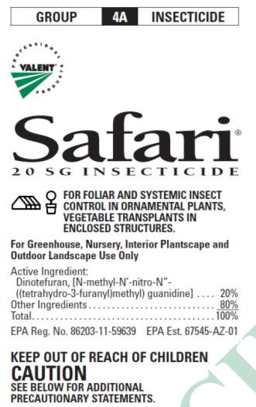
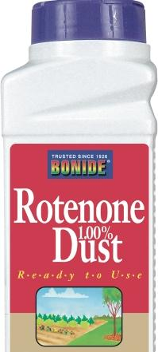
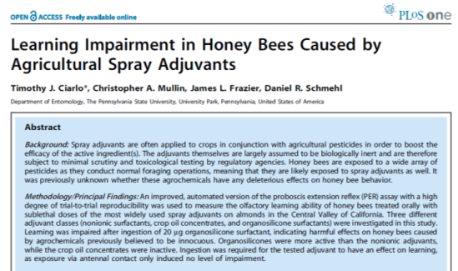
Formulation types differ in risk to pollinators
More risky
  Dusts
  Microencapsulated
  Wettable powders
  Flowables
  Emulsifiable concentrates
  Systemic products
  Some adjuvants
    Super-Organosilicone surfactants
No endorsement intended or implied
Notes:
Granular formulations are least hazardous because they are applied to the ground and are too big for bees to pick up. EC are safer than Wettable Powders because WP stay toxic longer. Dusts & Micro Encapsulated are most hazardous because they are similar in size to pollen and tend to stick to bee hairs, going back to the hive. Bees are temporarily inactivated by direct contact with oil sprays. Mixing miticides with insecticides can be more toxic to bees. Mixing some fungicides the (demethylation-inhibiting (DMI) like propiconizole (Propimax, Quilt) with synthetic pyrethroids like lamda-cyhalothrin (Warrior). Similar effects have been seen with Neonics and DMI fungicides but not translated out to the field (Schmuck ,etal 2003)

Slide 29
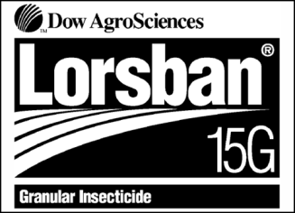
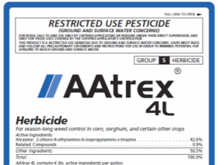
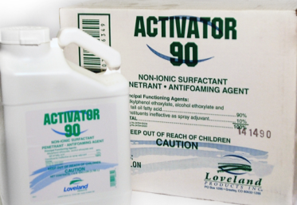
Formulation types differ in risk to pollinators
Less risky
  Non-systemic granules
  Soluble liquids and powders
  Oil sprays
  Some adjuvants
    Other non-ionic surfactants show some toxicity and
    crop oils are least toxic
No endorsement intended or implied

Slide 30
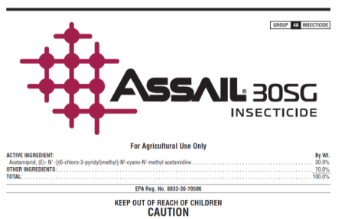
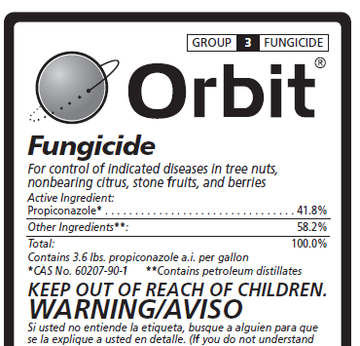
Different Tank Mixes may also increase risk to pollinators
Some combinations can be very risky…
  Insecticides mixed with miticides
  Insecticides mixed with fungicides or PBO
    Acetamiprid (Assail) and propiconazole (Orbit)
    Pyrethroids and propiconazole
    Piperonyl butoxide and some neonicotinoids
Avoid tank mixes entirely
No endorsement intended or implied

Slide 31
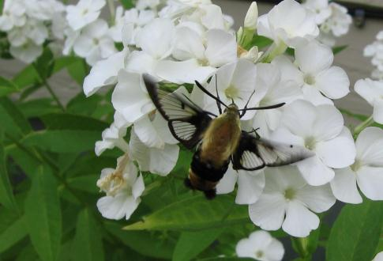
Pollinator Protection Checklist
Read and follow the label.
Determine if the pesticide is toxic to pollinators.
Learn about local pollinator visitation habits.
Use Integrated Pest Management.
Follow pesticide stewardship practices.
Cooperate and communicate with others.
Know symptoms of pesticide exposure to bees.
Check local ordinances pertaining to pollinators.

Slide 32
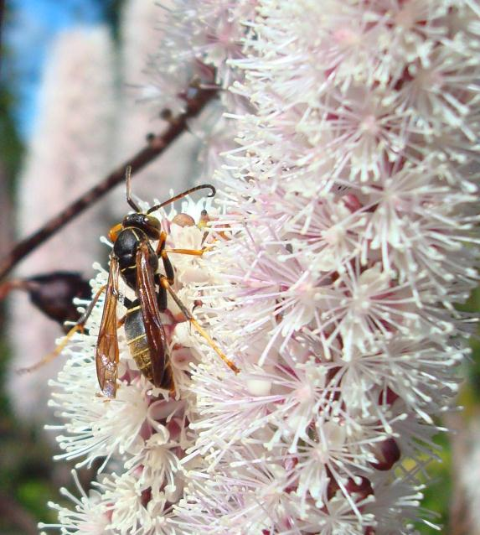
Pollinator Protection Checklist
1. Read and follow ALL pesticide label directions and precautions.
  Must reduce risk of
  pesticide exposure to
  honey bees and other
  pollinators.

Slide 33
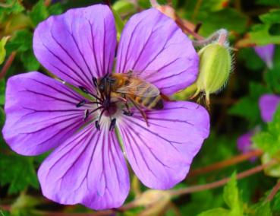
Many insecticides have specific label warnings

Slide 34
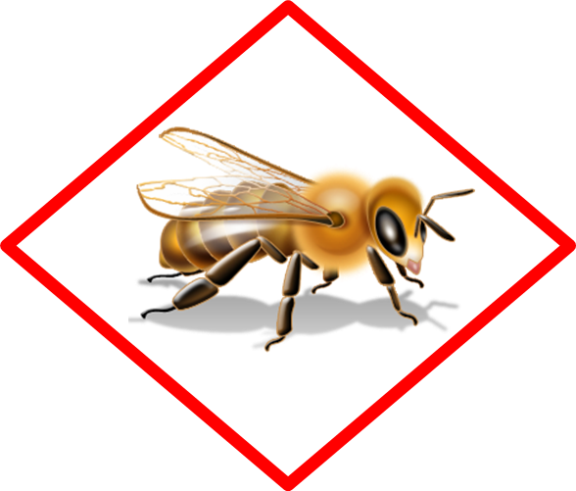
Look for the bee icon on new labels
Products with acute or residual toxicity to pollinators will have the bee icon on their labels
The new warnings will be next to that icon

Slide 35
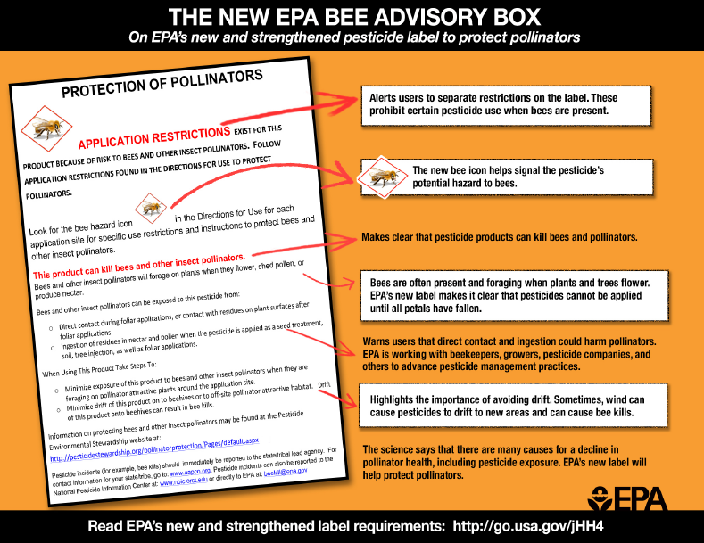
Pollinator Protection

Slide 36
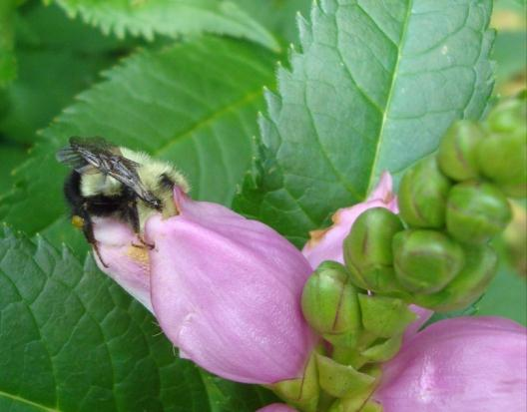
Pollinator Protection Checklist
2. Determine if the pesticide may be toxic to pollinators.
  The Environmental Hazard section of a label will indicate if a pesticide is moderately or highly toxic to bees that contact the pesticide.
  There is also a “practically non-toxic to pollinators” category of pesticides.

Slide 37
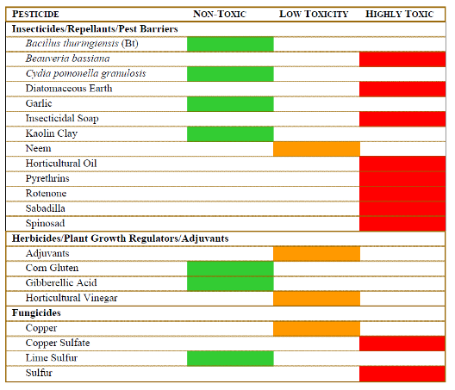
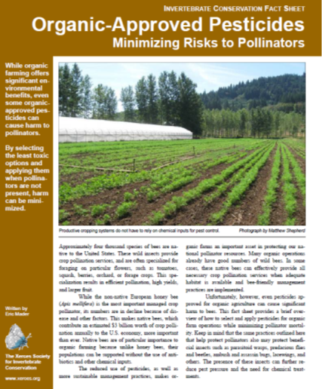
Even pesticides approved for organic grower use can be highly toxic to pollinators
Toxicity of Common Organic-Approved Pesticides to Pollinators
Soaps and Oils, only when directly sprayed upon the pollinator
Eric Mader – The Xerces Society for Invertebrate Conservation

Slide 38


Slide 39



Slide 40

New use directions – Ag products

Slide 41

New use directions – Ag products

Slide 42


New use directions – Ag products & Non-Ag products

Slide 43

The DACF has a registered beekeeper list
Urban & suburban applicators can contact the DACF apiarist to find out if any registered beekeepers are within 2 miles of the areas they are planning to apply pollinator toxic pesticides

Slide 44
Residual Toxicity
Definition:
Residues on plants which can harm pollinators that visit the area after the treatment is dry or absorbed by the soil
Some pesticides have extended residual toxicity to bees and other pollinators.

Slide 45


Residual Toxicity
If the pesticide does not have extended residual toxicity:
The pesticide can still harm pollinators exposed to direct treatment; during or shortly after the application while the plants are still wet.
Can often be applied after evening pollinator foraging is complete without harming pollinators that arrive the next day.

Slide 46

Additional Restrictions for pesticide with Extended Residual Activity www.epa.gov/pesticides/ecosystem/pollinator/bee-label-info-lrt.pdf

Slide 47



Northern wintered bees fly at lower temps
Northern bees may fly at temps in the mid – high 40’s
Especially to visit early blooming trees, shrubs and weeds
  Serviceberry
  Cherries
  Willow
  Crabapples
  Bluets
  Dandelion
  Rhodora

Slide 48

Residual Toxicity
Environmental conditions can affect residual toxicity.
  Examples: Low temperatures or heavy dews for the night or early AM after application may increase residual toxicity.

Slide 49

Pollinator Protection Checklist
3. Understand local pollinator visitation habits.
  Pollinators are at most risk when ANY vegetation is blooming.
  Observe application timing on the label relative to the blooming stage of crop and other plants.
  The right timing may be reduced by extended bloom or unfavorable weather conditions.
  Evening or nighttime applications are generally the least harmful to honey bees.

Slide 50


During Application
Watch for bee activity.
  Stop spraying if bees are present at the application site.
Be careful with refill or mixing/loading operations.
  Clean up any spills.
  Don’t contaminate any standing water.
Notes:
Conditions can change, so if you start early with your spray operation and then foraging bees enter the application site during application you may need to delay your application. Also, there may be places in your field that will attract bees in small locations. Pay attention to these areas and if there is significant activity, stop or delay spraying.
It is better to mix and load at a site away from the application site if there is bees in the area. Bees need water and might try to drink in puddles of spilled tankmix or will attempt to drink contaminated water. Clean up any spills and don’t leave any puddles or standing water at the mix/load site.

Slide 51

Pollinator Protection Checklist
4. Use Integrated Pest Management (IPM)
  Consider all suitable practices for managing pests.
  Use cultural practices that discourage pests from using a crop or landscape as a habitat.
  Carefully diagnose your pest problems.
  Monitor and assess pest populations to determine when levels warrant pesticide treatment.
www.gotpests.org

Slide 52

Pollinator Protection Checklist
4. Use Integrated Pest Management (IPM)
  Determine your best combination of management options.
  Use the recommended pesticide at the lowest appropriate labeled rate, based on the life stage of the pest/infestation level with the proper timing and placement.
    Using rates below the labeled rate may cause loss of control or development of pest resistance.

Slide 53

Pollinator Protection Checklist
5. Always follow pesticide stewardship practices.
  Minimize spray drift.
  Minimize volatility.
  Minimize off-site drift
  of seed treatment
  materials.

Slide 54


Minimize Spray Drift
Establish appropriate buffers.
Check weather forecast.
Shut off the sprayer when making turns and near ponds and other sources of water.
Choose low pressure or low-drift nozzles.
C. Black, Spain 2013

Slide 55

Minimize Vapor Drift
More prone to pesticides formulated as emulsifiable concentrates.
Spray during cool temperatures.
Soil-incorporate volatile products.
Use relatively coarse spray droplets.

Slide 56

Minimize Off-Site Drift of
Seed Treatment Materials
Specific label information takes precedence.
Always buy and use high quality seed, free from excessive dust.
When the pesticide needs to be coated onto the seed, always use an appropriate coating system to keep abrasion of coated pesticide to a minimum.

Slide 57
Minimize Off-Site Drift of
Seed Treatment Materials
Follow planter manufacturer recommendations for use of talc, graphite, or other flow agent.
  Avoid excess to minimize dust.
Avoid releasing dust from seed treatments into the air that could expose pollinators.
  Be careful when opening seed containers and when filling, emptying, or cleaning the planting equipment.

Slide 58


After Application
Properly dispose of leftover tank mix, rinsates and wash waters.
  Bees are attracted to water sources.
  Cover, drain, or dispose of any puddles or pools.
Store unused pesticides in a secure facility.

Slide 59

Pollinator Protection Checklist
6. Cooperate and communicate with others who are concerned about preserving beneficial insects, including pollinators.
  Beekeepers
  Custom applicators
  Neighboring growers
Penn State Pesticide Education Program

Slide 60
Pollinator Protection requires COMMUNICATION!
Growers
Applicators
PROTECT
THE
POLLINATORS
Beekeepers

Slide 61

What Can You Do…?
As a Beekeeper…
  Notify applicator of the location of hives
  Have your contact information on the hives
  All bee medications, even organic ones, (miticides) can also contribute to these problems. Minimize your use
http://scientificbeekeeping.com/
Notes:
Notify the beekeeper about application time and product to be used; so he can anticipated outcomes.
Timing of insecticide application: Never spray a crop in bloom unless it's absolutely necessary. If spraying a crop in bloom is necessary, spray when there will be minimal bee activity, preferably during the evening hours. Evening spraying also allows the insecticide to dry on the crop before bee activity begins the next morning.
Modify control programs according to weather. Cold temperatures prolong the residual of insecticide while warm temperatures break down insecticides more rapidly. Warm temperatures in late afternoon, early evening or early morning can "hold" bees in blooming fields for longer periods. Pay attention to wind direction and velocity in relation to nearby beeyard locations.
Why is the beekeeper hesitant to move or why does he sometimes leave the colonies in the area?
The colonies may contain new combs filled with honey that will break under vibration by the truck that hauls them over rough roads. If this occur, the bees in the cluster will be drowned by the honey and the combs lost. Finding an appropriate location may be difficult (road to them, shade, food, pesticides used in the area, etc)

Slide 62


What Can You Do…?
  When highly toxic & long residual pesticides are applied nearby:
    consider moving hives
  When highly toxic & short residual pesticides are applied nearby :
    confine your bees
http://www.aces.uiuc.edu/vista/html_pubs/BEEKEEP/CHAPT6/chapt6.html

Slide 63

Pollinator Protection Checklist
7a. Know the common symptoms of honey bee exposure to pesticides
7b. Know what other stressors impact bee health.
iStockphoto.com

Slide 64

Common Symptoms of Honey Bee Exposure to Pesticides
Excessive numbers of dead bees in front of hives.
Lack of the usual numbers of foraging bees, if not weather-related.
Bees in front of hives that appear disoriented and unable to fly.
www.hive-mind.com

Slide 65


Common Other Stressors to Bee Health
Colony starvation and nutritional deficiency.
Excessive cooling or heating
of the colony and brood.
Parasites.
www.gardenfork.tv
cyberbee.net/gallery

Slide 66

Pollinator Protection Checklist
8. Check for specific local ordinances pertaining to pollinators,
especially beehive
locations or
designated
preserves.

Slide 67

What we all can do to improve pollinator survival?
Grow plant for pollinators
Convert lawns and fallow field areas to bee gardens or bee pastures
Simply planting clovers, sunflowers or asters can make a big difference
Attracting Beneficial Insects with Native Flowering Plants
by Doug Landis, Rufus Isaacs

Slide 68
Use of this presentation or parts of this presentation is encouraged as long as this credit slide is included.
Photo/Graphic Credits:
Tom Butzler, Penn State Extension (slides 2, 3, and 4).
Environmental Protection Agency (slides 8, 12, and 30).
iStockphoto.com (slides 25 and 27).
Penn State Pesticide Education Program (slides 5, 7, 24, and 28).
Resources:
Bee Labeling Info Graphic (PDF). U.S. EPA.
http://www.epa.gov/opp00001/ecosystem/pollinator/bee-label-info-graphic.pdf
Pollinator Protection web page, U.S. EPA. http://www.epa.gov/pesticides/ecosystem/pollinator/
Pollinators and Pesticide Stewardship. Coalition for Urban/Rural Environmental Stewardship, Syngenta, and Bayer CropScience.
http://pesticidestewardship.org/pages/resources.aspx

Slide 69

This presentation was created in partnership with the
Pesticide Education Program, Penn State Cooperative Extension;
and the Pennsylvania Department of Agriculture.
It was slightly modified by
Washington State University
Urban IPM and Pesticide Safety Education Program
Where trade names appear, no discrimination is intended, and no endorsement by WSU or Penn State Cooperative Extension is implied. WSU and Penn State is committed to affirmative action, equal opportunity, and the diversity of its workforce.
© The Pennsylvania State University 2013 September 2013

Slide 70
Other contributors to this presentation
Frank Drummond – University of Maine
Tony Jadczak - MDACF
Sherm Takatori – Idaho Department of Agriculture
Thia Walker - Colorado State University
Carol Black – Washington State University
Jack Peterson – Arizona Department of Agriculture
Kerry Richards – Penn State University

Slide 71
Resources
http://www.usda.gov/documents/ReportHoneyBeeHealth.pdf
‎http://www.beeccdcap.uga.edu
http://pesticidestewardship.org/PollinatorProtection/Pages/default.aspx
http://www.epa.gov/opp00001/ecosystem/pollinator/

Slide 72
Questions?
That’s all folks!

